Slide 1
TOTAL WORKPLACE INNOVATION
The paradigm that will change the organisation
ODAM 17th-20th August 2014
NES Copenhagen, Denmark
2014 Prof. dr. Geert Van Hootegem

Slide 2
Some observations
Big bang: not observed;
SME’sation: not observed;
Market instead of organisation: not observed;
Break down of employment relationship as dominant economic coordination mechanism: not observed;
Flattening hierarchies: not observed;
Functional organising: even more dominant then ever before
  AND WE KNOW IT AS A WORKER, A CUSTOMER, A CITIZEN, … HUMAN FACTORS RESEARCHER

Slide 3
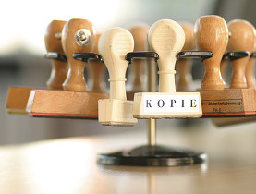
THE BUREAUCRACY

Slide 4
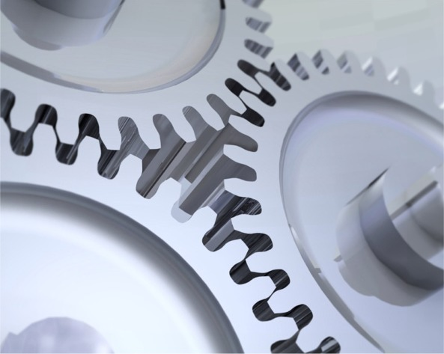
SPECIALISATION AND LACK OF JOB CONTROL

Slide 5
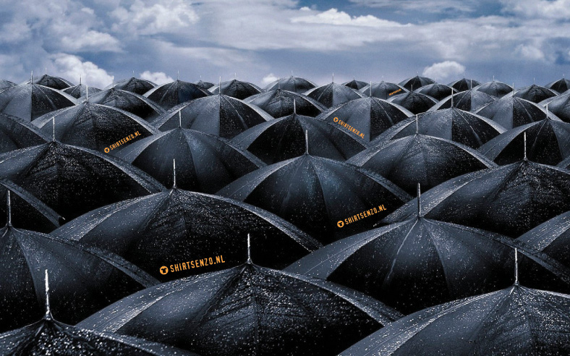
THE UMBRELLA SYNDROME

Slide 6
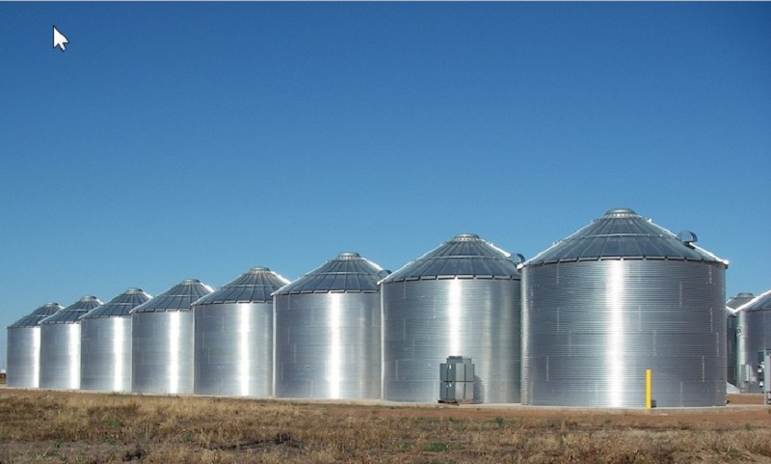
SILO THINKING

Slide 7
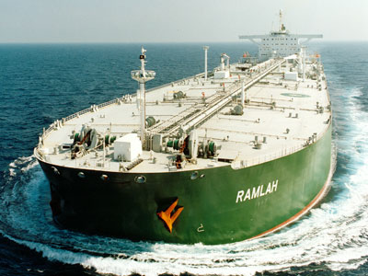
FLEXIBILITY & AGILITY

Slide 8
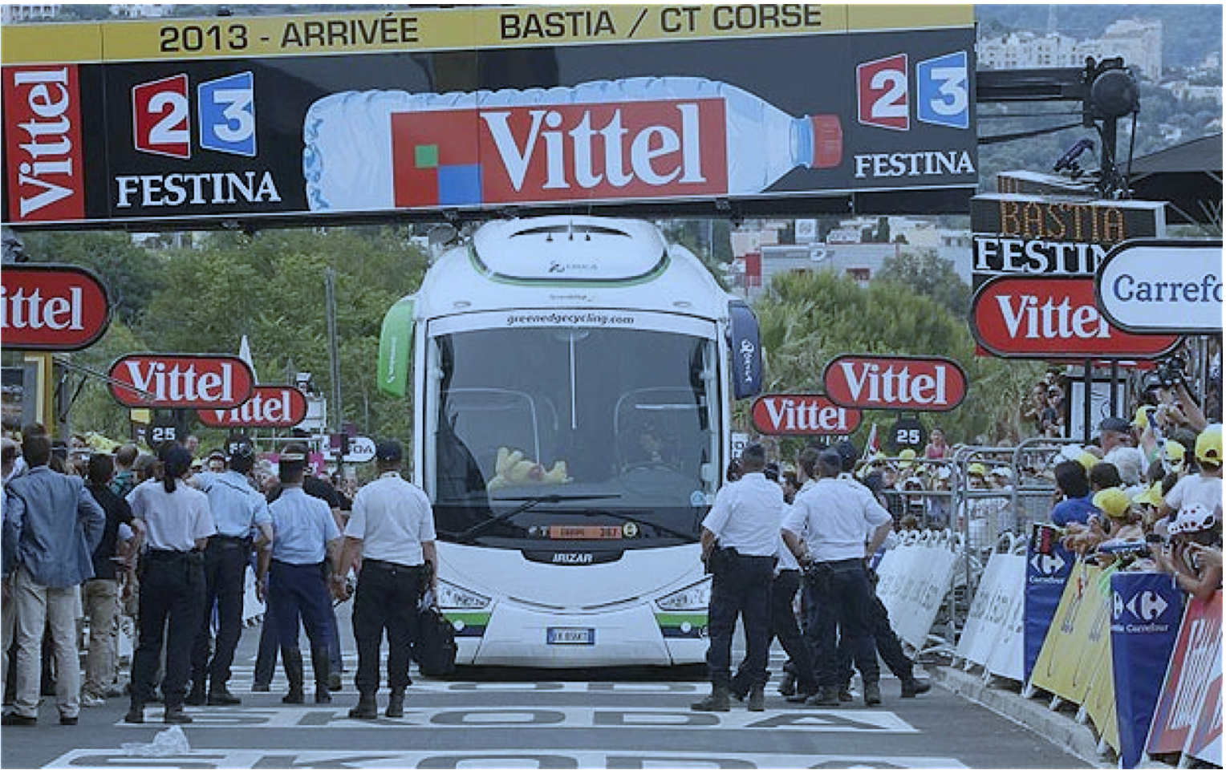
Organisational Failure

Slide 9
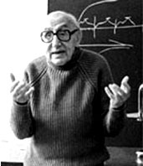
“(…) organisations are still so imperfectly designed and our ignorance about them is so great that forms of malfunctioning and the suffering which results from it are ubiquitous and are widely accepted as normal and unavoidable.”
(Elias and Scotson, 1965)

Slide 10
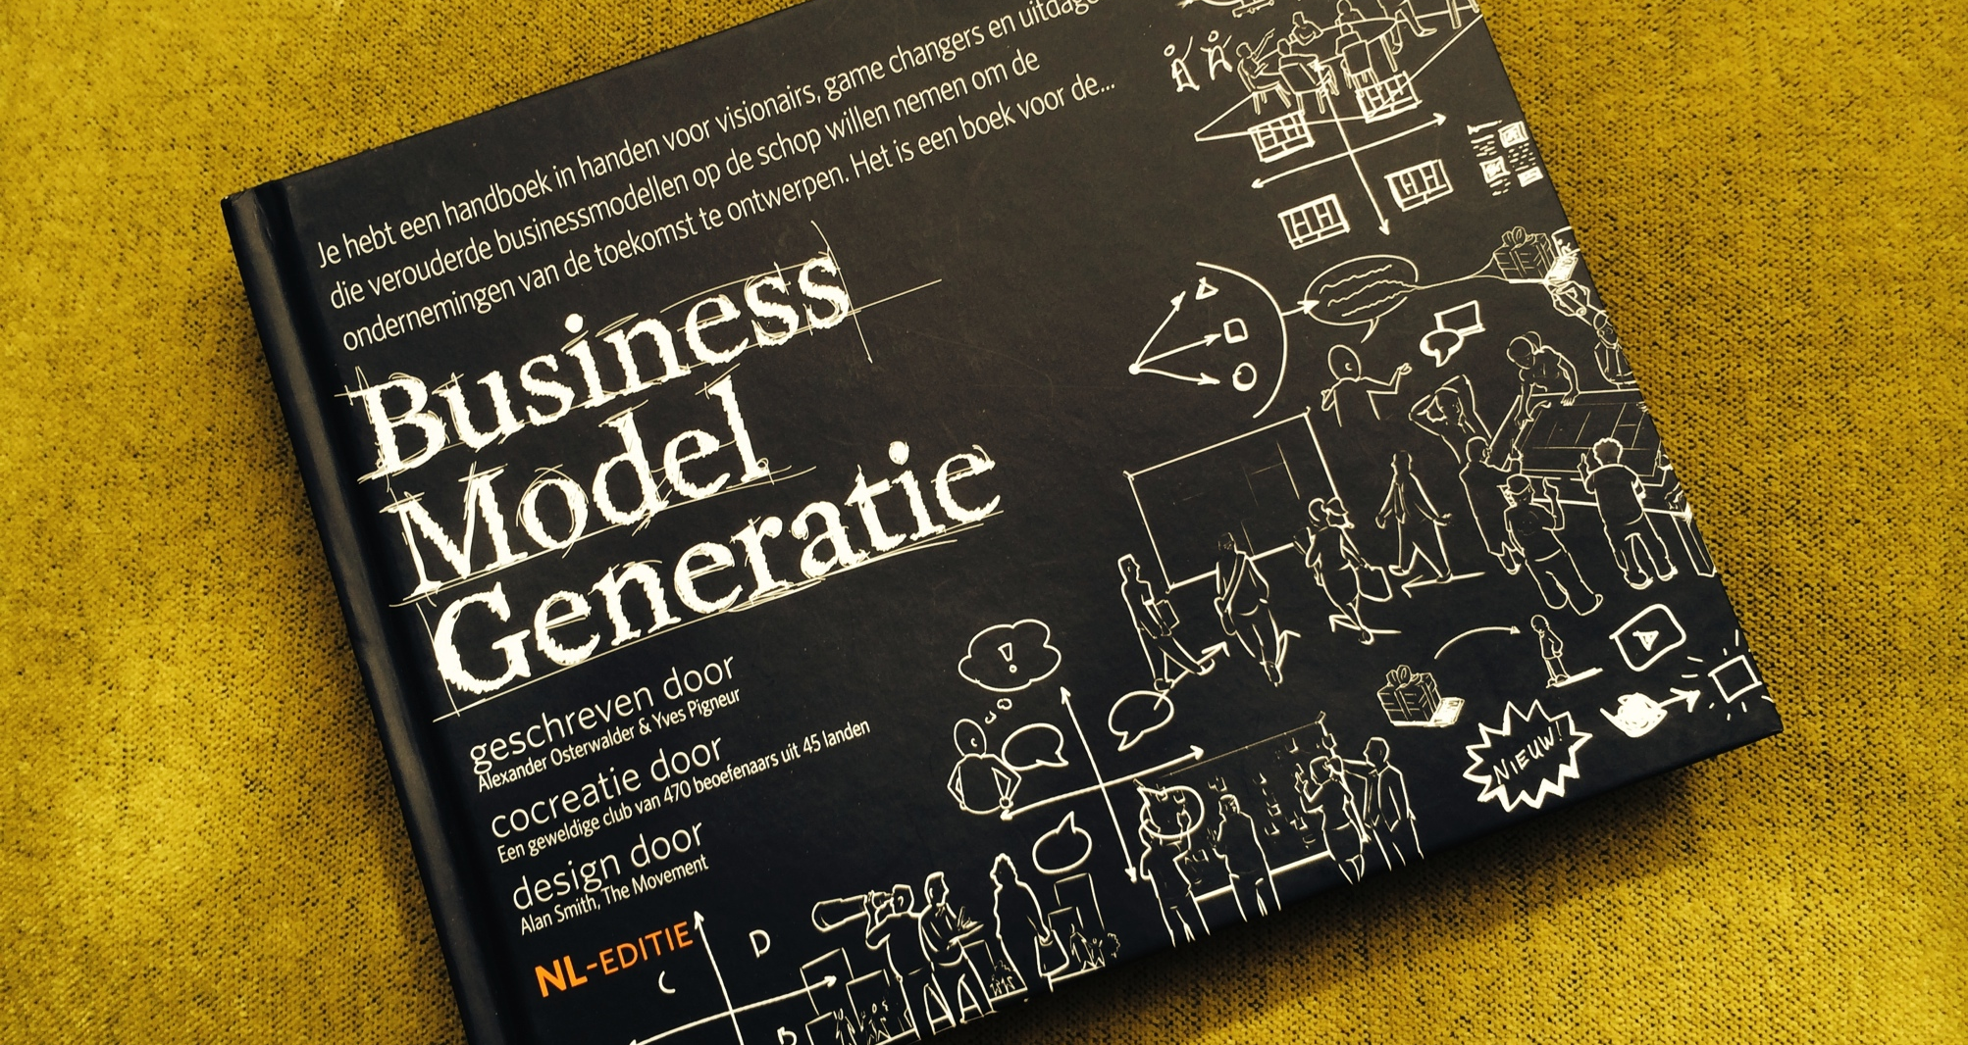

Slide 11
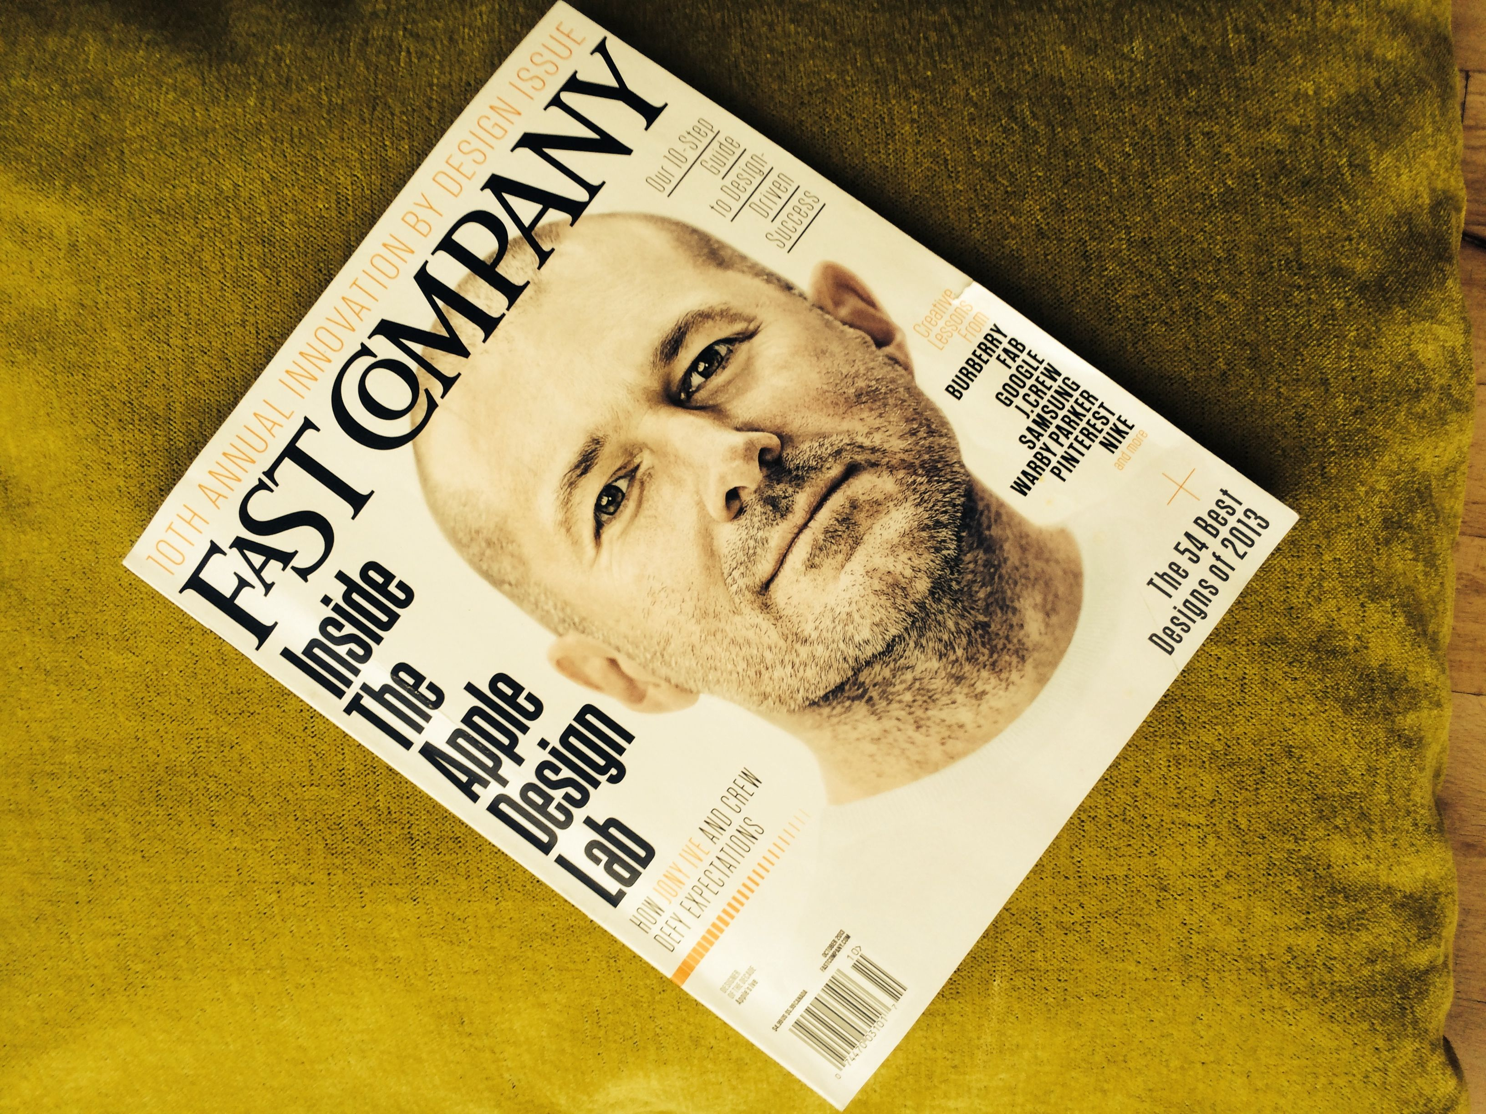

Slide 12
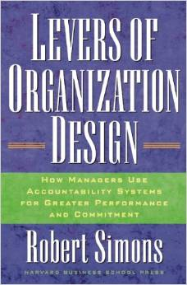

Slide 13
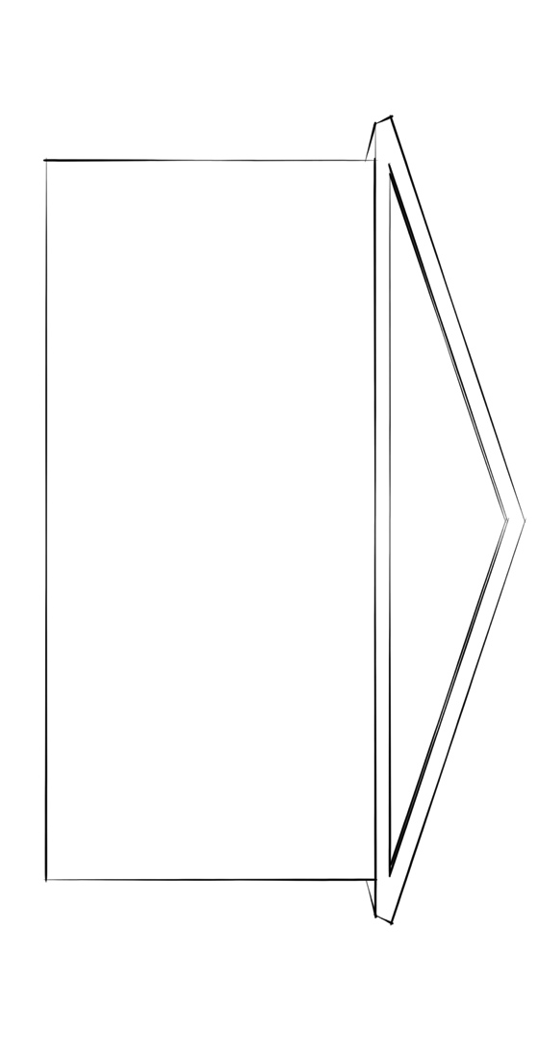
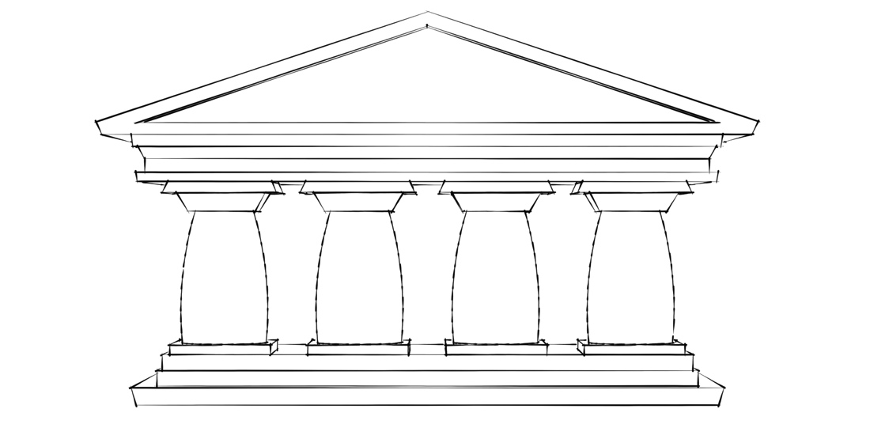
IN
put
OUT
put
Transformation
Notes:
Input througput output schema (met tempelmodel vaag op de achter-grond

Slide 14
HUGE WORKFORCE
+
LOW SKILLED WORKFORCE
IN
put
OUT
put
Transformation
Notes:
Input = Veel Arbeidskrachten + laag geschoolde arbeidskrachten

Slide 15
DESIRED
+
Non DESIRED: inequality, disease and ecological footprint
LOTS OF WORKFORCE
+
LOW SKILLED WORKFORCE
IN
put
OUT
put
Notes:
Output= desired (VUCA laag), VUCA animeren non desired: ongelijkheid, ziekte en ecologische footprint

Slide 16
Volatility
Ambiguity
Uncertainty
Complexity

Slide 17
Performance Requirements
2010
Workability
+
Employee
driven
Service
Sustainibility
2000
Service
Sustainibility
+
Customer
driven
Innovativity
Innovativity
1990
Innovativity
+
Question
driven
Flexibility
Flexibility
Flexibility
1980
Flexibility
+
Customer
friendliness
Quality
Quality
Quality
Quality
1970
Quality
+
Offer
driven
1960
Efficiency
Efficiency
Efficiency
Efficiency
Efficiency
Efficiency
Notes:
17
17

Slide 19
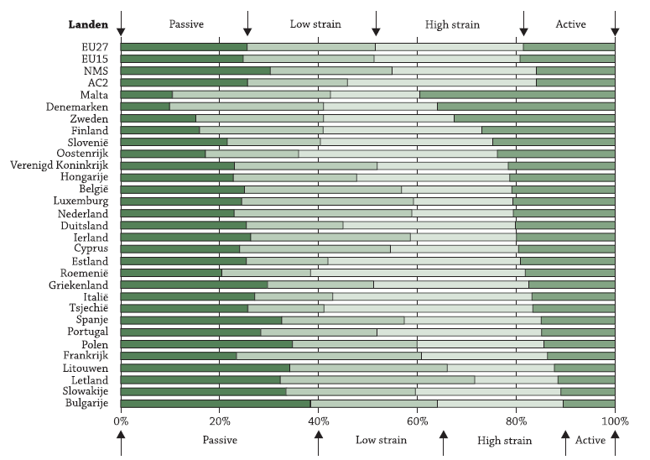
EUROPEES PERSPECTIEF

Slide 20
Specs for New Organisational Design Theory
Integral view
(New) Theory based
TWIN for TWINS:
  Organisational Performance + QWL
VUCA-proof
Declining Labour market:
  Highly skilled workers
  Diverse workforce (esp. multigenerational)
  Making voice
Sustainable in a global competing economy

Slide 21
IN
put
OUT
put
Transformation
Notes:
Input througput output schema (met tempelmodel vaag op de achter-grond

Slide 22
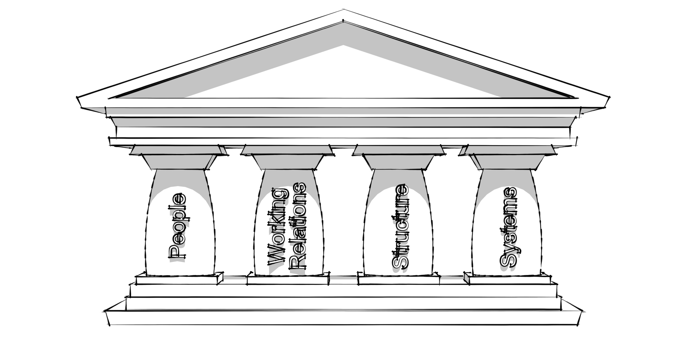
Need for integral view
People
Culture
structure
systems
Notes:
Input througput output schema (met tempelmodel vaag op de achter-grond

Slide 23
Need for integral view
QUALITY OF THE
ORGANISATION
QUALITY OF
WORKING LIFE
PeopLE
CULTURE
STRUCTURE
SYSTEMS
leadership
Strategy, mission, vision, performance requirements

Slide 24
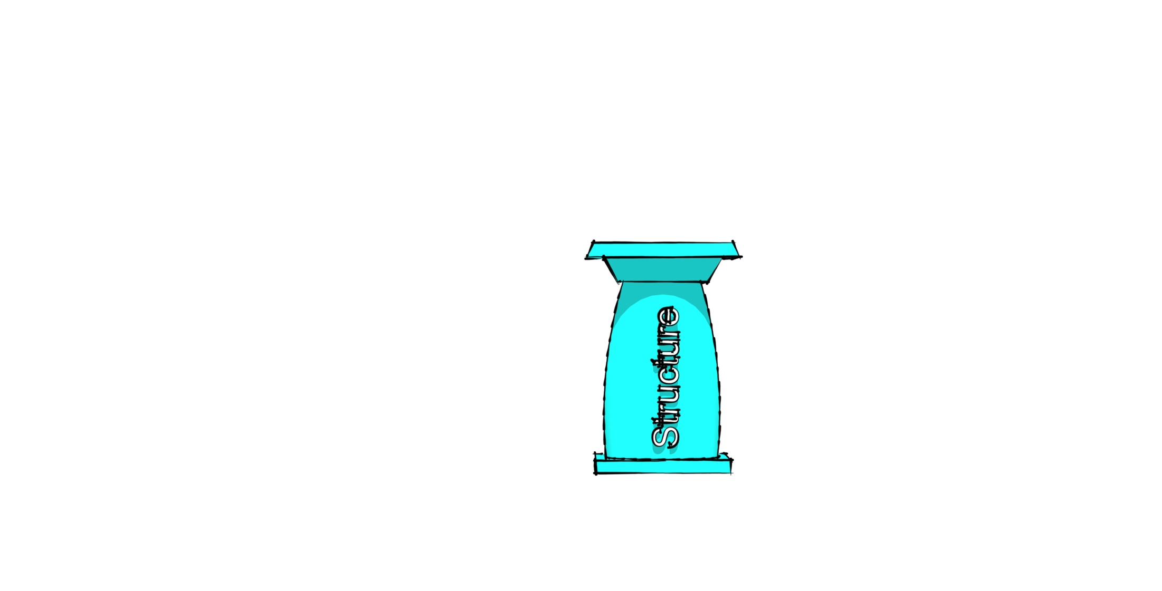
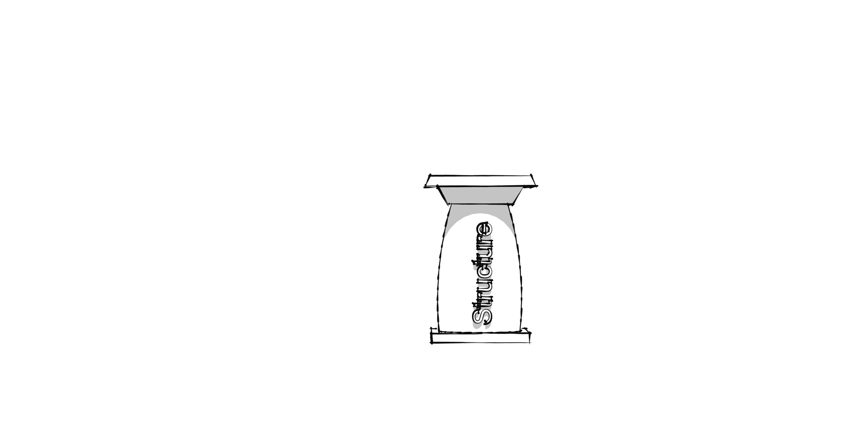
Need for integral view (2)
QUALITY OF the
ORGanisation
QUALITY OF
WORKING LIFE
People
Culture
structure
systems
leadership
Strategy, mission, vision, performance requirements

Slide 25
MST perspective on organisations
& their environment
Technology
production
organisation
Work
organisation
Work division
Workplaces
Membershiprelations
Employment Relationship
Allocation
Discipline
Industrial Relations
25
Notes:
©2003 Katholieke Universiteit Leuven
25

Slide 26
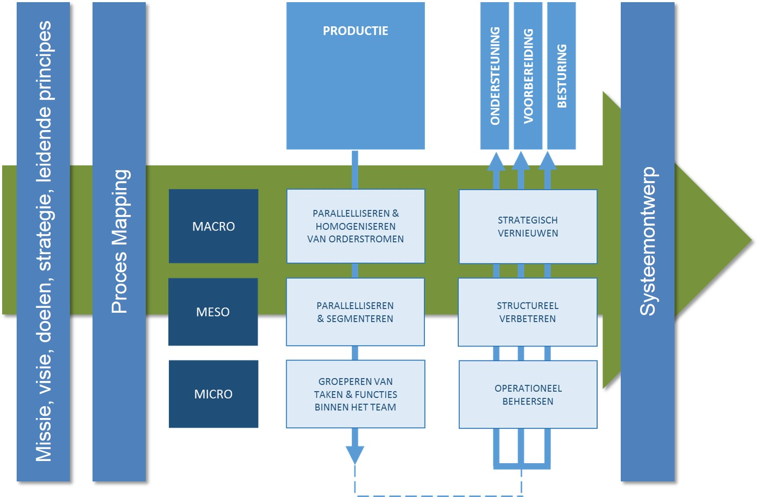
PRODUCTION
OR
€/$
PREPARATION
CONTROL
SUPPORT
PARALLELISATION
& HOMOGENISATION
OF ORDER FLOWS
STRATEGIC
INNOVATION
Mission, Vision,Strategy, Performance requirements
System Design
Process Mapping = boundaries N+1
PARALLELISATION
& SEGMENTATION
STRUCTURAL
IMPROVEMENT
GROUPING OF
TASKS AND
FUNCTIONS WITHIN
THE TEAM
OPERATIONAL
CONTROL

Slide 27
MST perspective on organisations
& their environment
Technology
production
organisation
Work
organisation
Work division
Workplaces
Membershiprelations
Employment Relationship
Allocation
Discipline
Industrial Relations
27
Notes:
©2003 Katholieke Universiteit Leuven
27

Slide 28
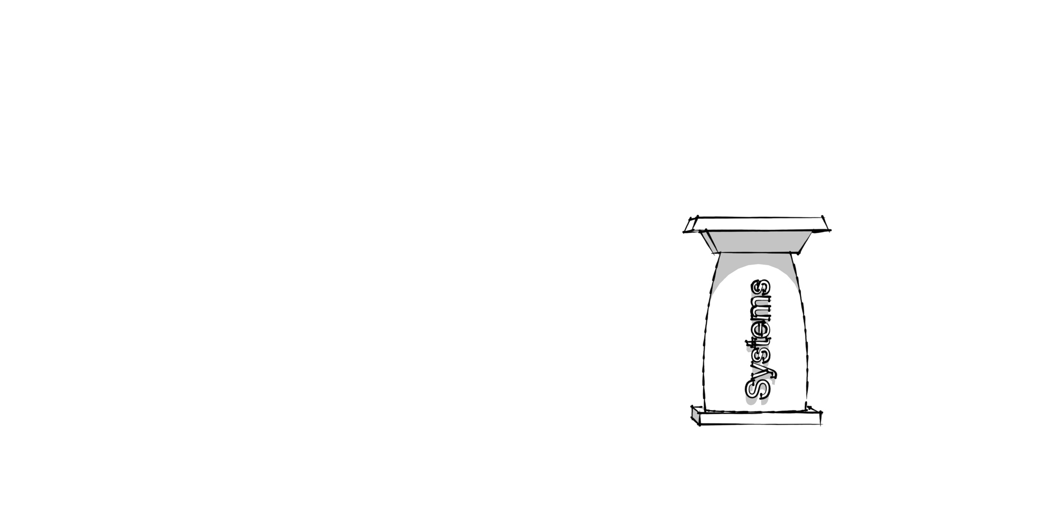
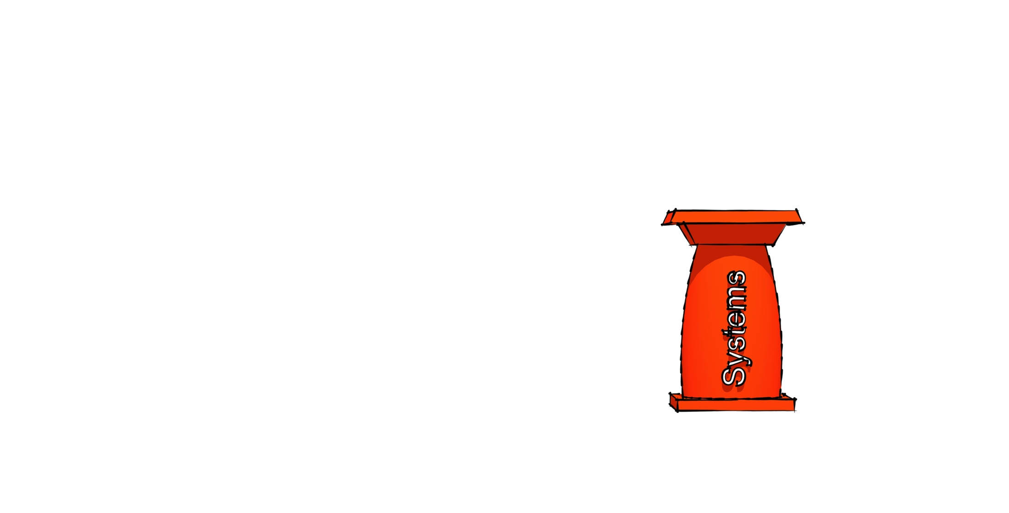
VUCA
Volatility – Uncertainty – Complexity - ambiguity
QUALITY OF the
ORGanisation
QUALITY OF
WORKING LIFE
People
Culture
structure
systems
leadership
Strategy, mission, vision performance requirements

Slide 29
SYSTEMS
First designing the structure, then systems
  ICT
  Architectural
  HRM
  …
Integrate lean thinking and be aware of 8.5 forms of waste

Slide 30
Principles of TWIN
Boundary Management (insourcing!)
Shift the Silo’s and the result is …
Multidisciplinary teams responsible for a whole stream of orders (objects, patients, students, …) with a high intradependency and low interdependency
A bundle of operations to be performed by a group of people is the basic element of the organisation (and NOT a function)
By default: processes can be different even if standardized (Striving for balance by asymmetry by design)
  On behalf of customer requirements
  On behalf of workforce diversity

Slide 31
Principles of TWIN (2)
Preparing and supporting functions decentral by default using the UNLESS-technique or principle
Governance structure is designed
  As latest step in the design process
  Bottom up
Workforce Mobility as assignment
Lateral functions or requirements like safety, health, innovation, learning, etc. are locked in daily operation routines, just like TOTAL QUALITITY PRODUCTION
… TOTAL WORKPLACE INNOVATION

Slide 32
NEW DESIGN, OLD FOUNDATIONS
OLD DAYS
Taylor
(scientific management)
A. Smith
Specialization Labor
H. Ford Assembly Line

Slide 33




Slide 34
NEW DESIGN, OLD FOUNDATIONS
OLD DAYS
TRANSITION
Taylor
(scientific management)
Goals = sustainability + €
A. Smith
Specialization Labor
Bifurcation
H. Ford Assembly Line
US Human Relation School
Japanese Just
in Time
Group Dynamic
Wisdom
Goals = €

Slide 35




Slide 36
NEW DESIGN, OLD FOUNDATIONS
OLD DAYS
TRANSITION
Taylor
(scientific management)
Goals = sustainability + €
Scand. Socio-Technical II
E. Trist Socio-Technical
Movement
A. Smith
Specialization Labor
Industrial
Democracy
Bifurcation
H. Ford Assembly Line
US Human Relation School
Japanese Just
in Time
Group Dynamic
Wisdom
Goals = €

Slide 37
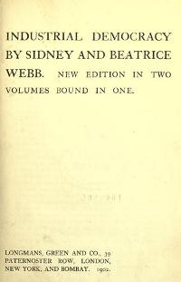
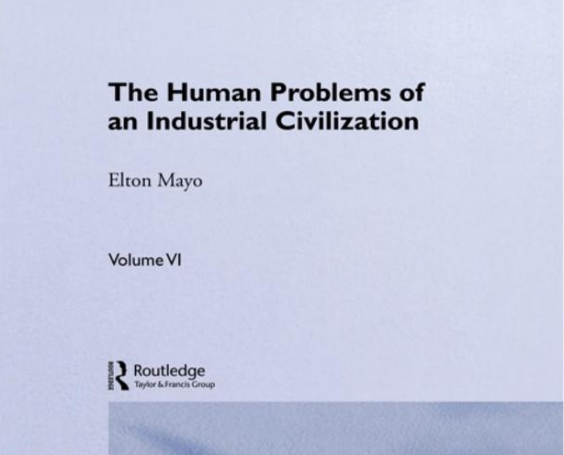
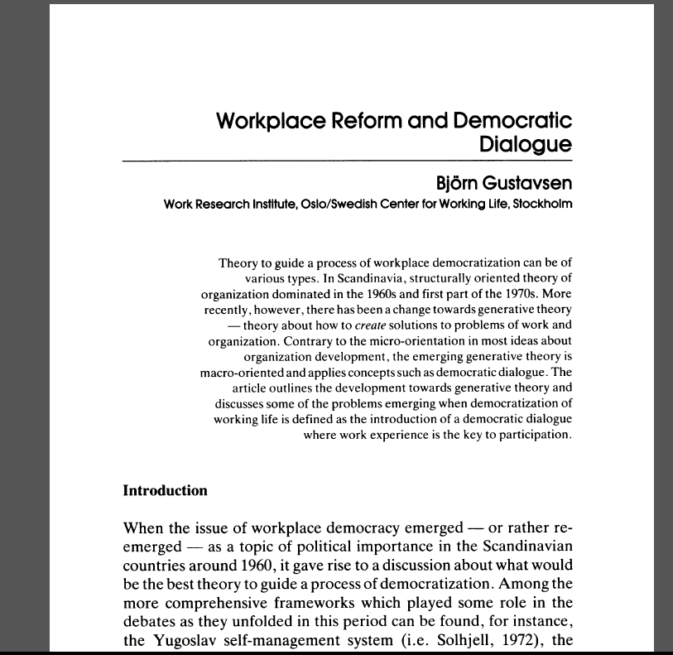
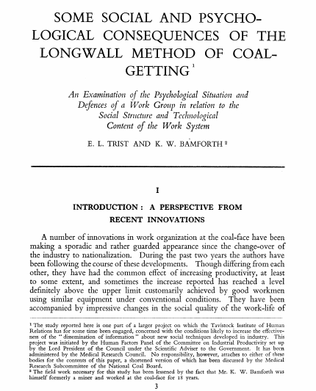

Slide 38
NEW DESIGN, OLD FOUNDATIONS
OLD DAYS
TRANSITION
Taylor
(scientific management)
Goals = Sustainability + €
Scand. Socio-Technical II
E. Trist Socio-Technical
Movement
A. Smith
Specialization Labor
Industrial
Democracy
Bifurcation
H. Ford Assembly Line
Reengeneering
US Human Relation School
Lean Production
Japanese Just
in Time
Group Dynamic
Wisdom
Goals = €

Slide 39



Slide 40
NEW DESIGN, OLD FOUNDATIONS
OLD DAYS
TRANSITION
NEW WORLD
Conducive Production
Taylor
(scientific management)
Goals = sustainability + €
Reflexive
Production
Scand. Socio-Technical II
E. Trist Socio-Technical
Movement
Total Workplace Innovation
A. Smith
Specialization Labor
MST Lowlands
New Goal Structure
Industrial
Democracy
Bifurcation
H. Ford Assembly Line
Reengeneering
US Human Relation School
Lean Production
Japanese Just
in Time
Group Dynamic
Wisdom
Goals = €

Slide 41
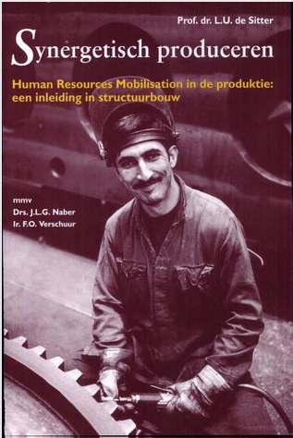

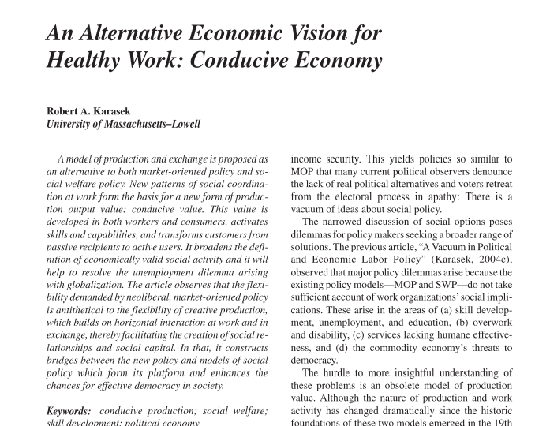

Slide 42
NEW DESIGN, OLD FOUNDATIONS
OLD DAYS
TRANSITION
NEW WORLD
Conducive Production
Taylor
(scientific management)
Goals = sustainability + €
Reflexive
Production
Scand. Socio-Technical II
E. Trist Socio-Technical
Movement
Total Workplace Innovation
A. Smith
Specialization Labor
MST Lowlands
New Goal Structure
Industrial
Democracy
Bifurcation
H. Ford Assembly Line
Reengeneering
US Human Relation School
Lean Production
Japanese Just
in Time
Group Dynamic
Wisdom
Goals = €

Slide 43
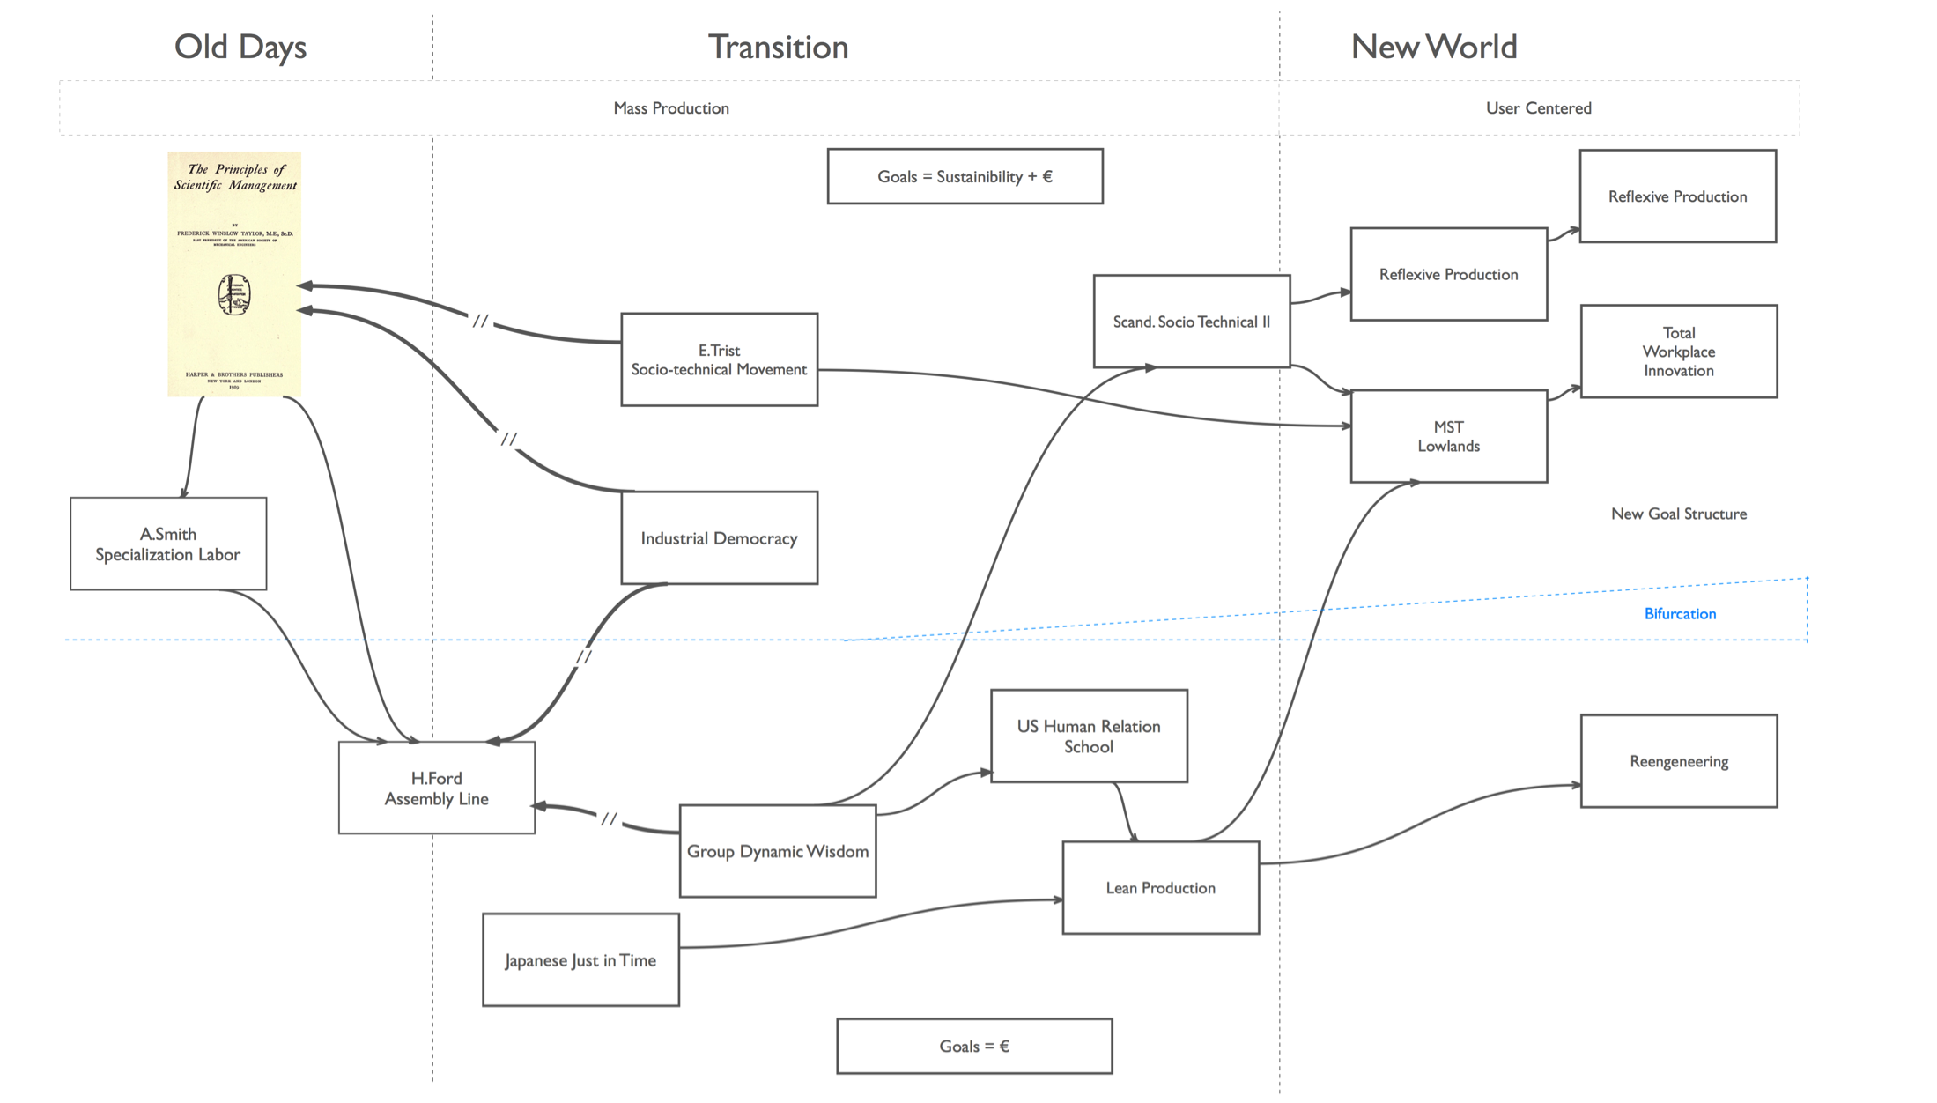
New Design, Old Foundations

Slide 44
Old Connections, New Movements

Slide 45
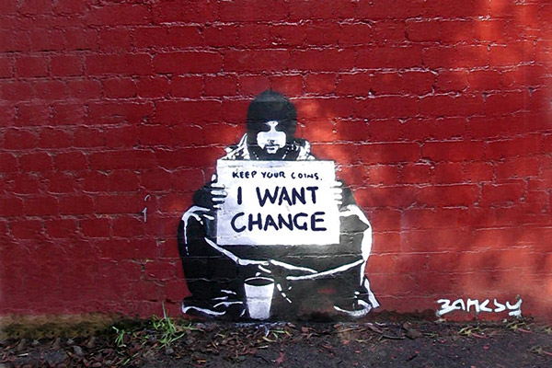

Slide 46
Thank you for your attention!
contact:
geert.vanhootegem@kuleuven.be
sam.pless@kuleuven.be

